Slide 1
CLOCS - Contrastive Learning of Cardiac Signals
By University of Oxford
Xiaoyu Li
2020.6.19

Slide 2
Background and Motivation
The healthcare industry generates troves of unlabelled physiological data → Contrastive Learning
Most research in this domain has focused on curating a positive set of examples by exploiting data temporality [Oord et al., 2018], data augmentations [Chen et al., 2020], and multiple views of the same data instance [Tian et al., 2019]. Central to their implementation is the notion that shared context arises from the same instance. → In medicine, shared context can occur at a higher level, the patient level.

Slide 3
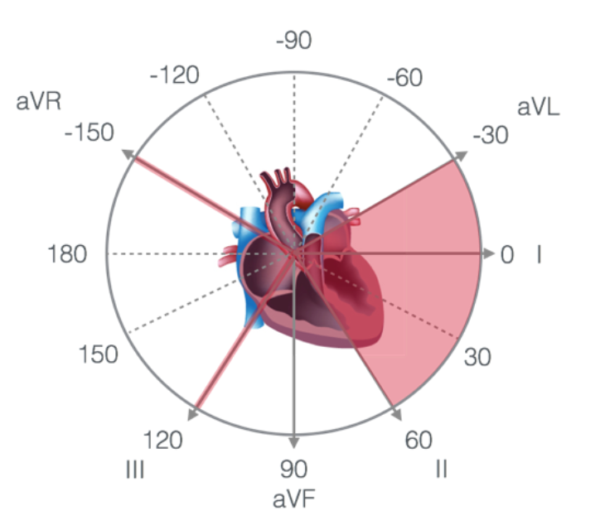
Method
Contrastive Multi-Segment Coding - we encourage representations of pairs of temporal segments of data from the same patient to be similar to one another.
Contrastive Multi-Lead Coding – we encourage representations of multiple views (electrocardiogram leads) of the same temporal segment from the same patient to be similar to one another.
Contrastive Multi-Segment and Multi-Lead Coding - we encourage representations of both temporal segments and multiple leads from the same patient to be similar to one another.

Slide 4
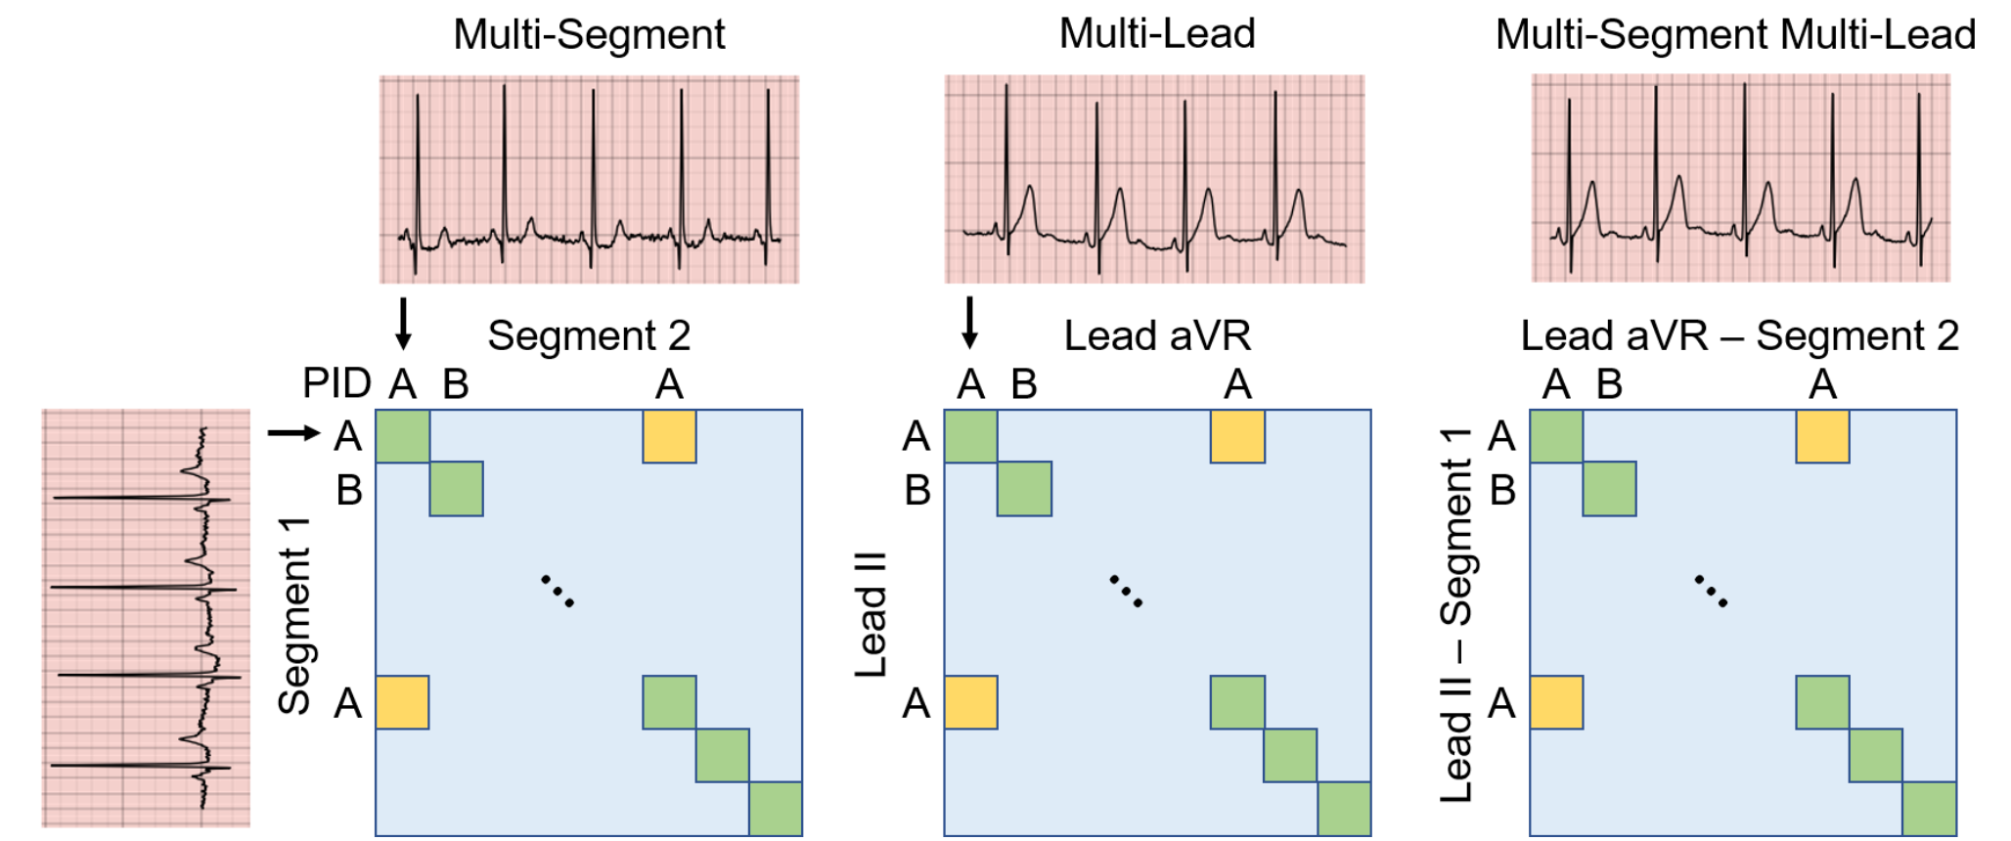
Method

Slide 5
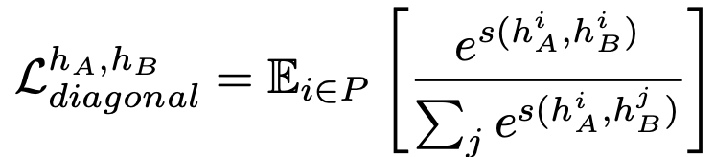
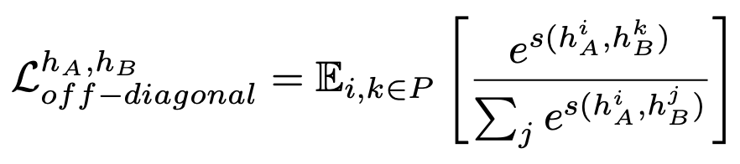
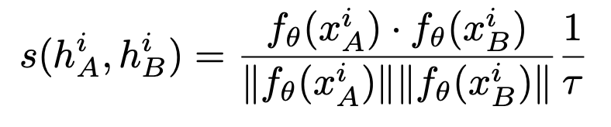
Method

Slide 6
Datasets
PhysioNet 2020 consists of 12-Lead ECG recordings from 6,877 patients alongside 9 different classes of cardiac arrhythmia. Each recording can be associated with multiple labels.
Chapman [Zheng et al., 2020] consists of 12-Lead ECG recordings from 10,646 patients alongside 11 different classes of cardiac arrhythmia.
PhysioNet 2017 [Clifford et al., 2017] consists of 8,528 single-lead ECG recordings alongside 4 different classes.
Cardiology [Hannun et al., 2019] consists of single-lead ECG recordings from 328 patients alongside 12 different classes of cardiac arrhythmia.

Slide 7
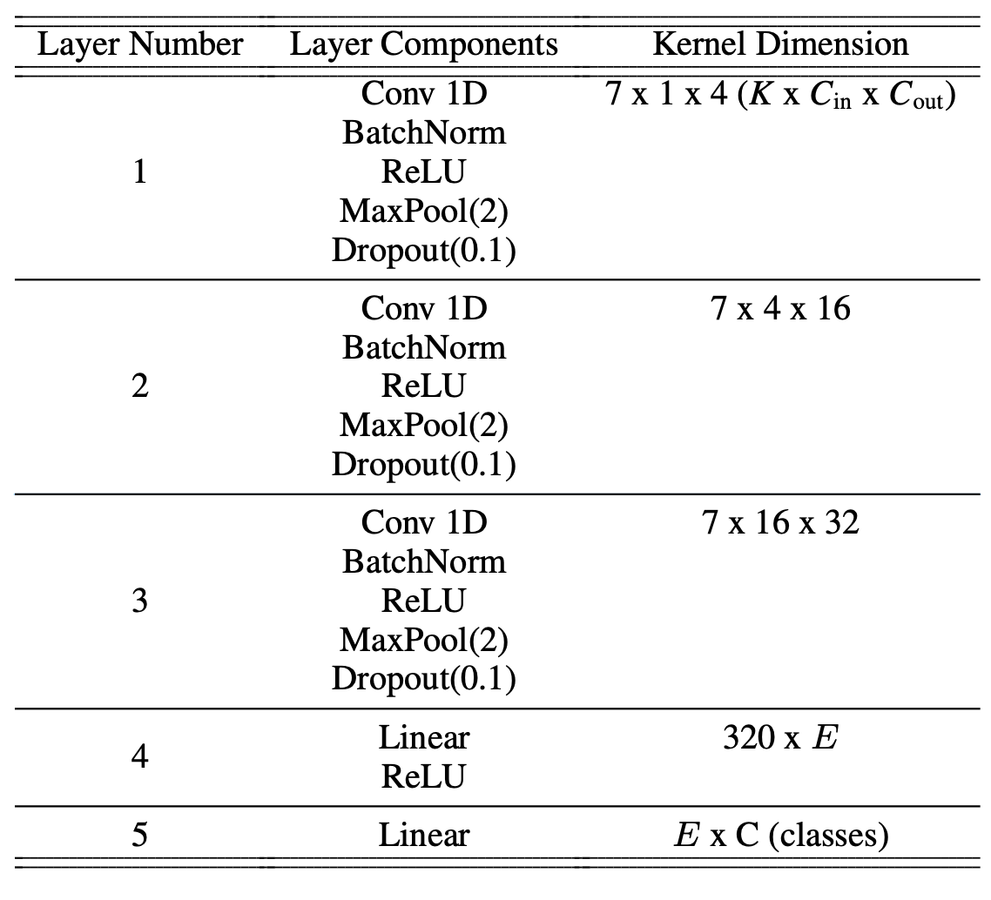
Implementation and Baseline
SimCLR
Random initialization
CMSC – temporal segments
CMLC – multiple leads
CMSMLC - both

Slide 8
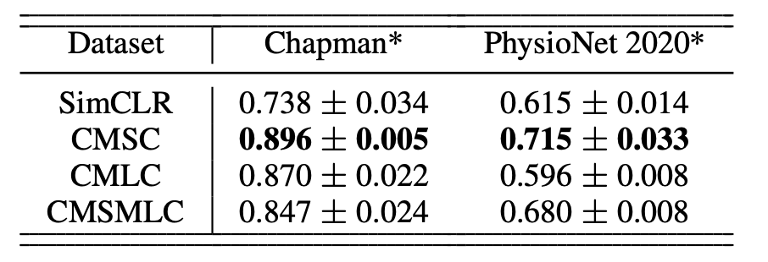
Evaluation- Linear Evaluation of Representations
test AUC on Chapman and PhysioNet 2020 using 50% of the labelled data (F = 0.5),after having learned representations, with dimension E = 128

Slide 9
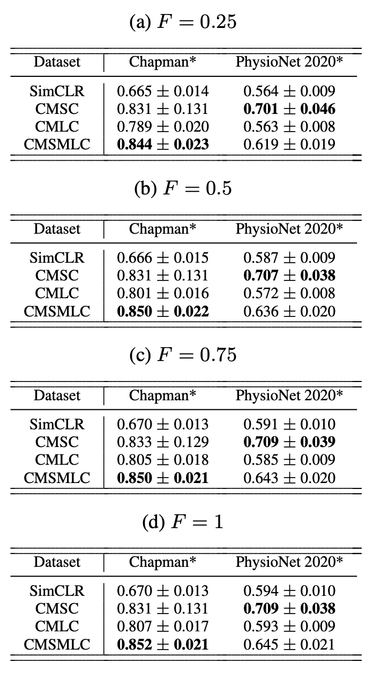
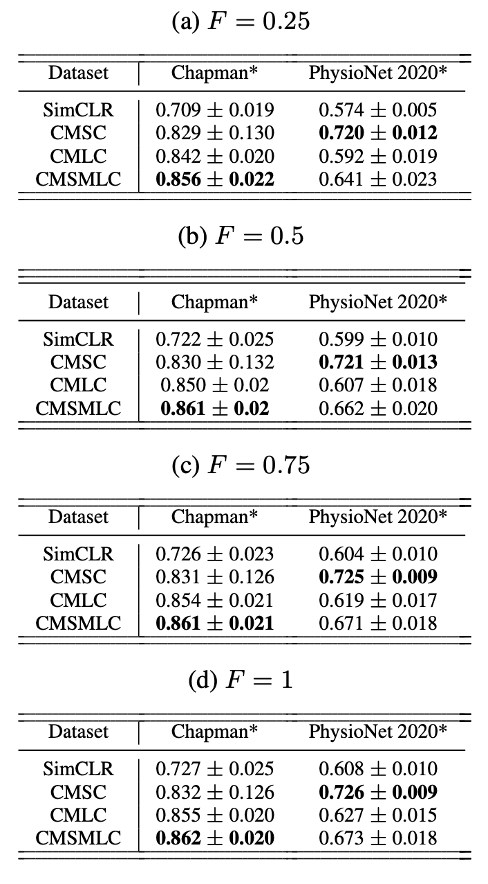
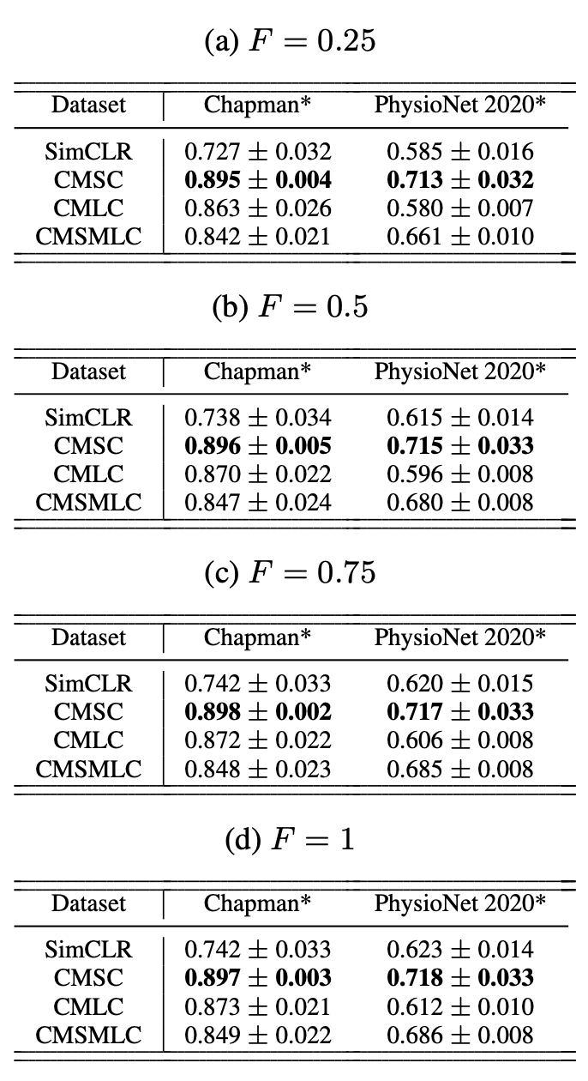
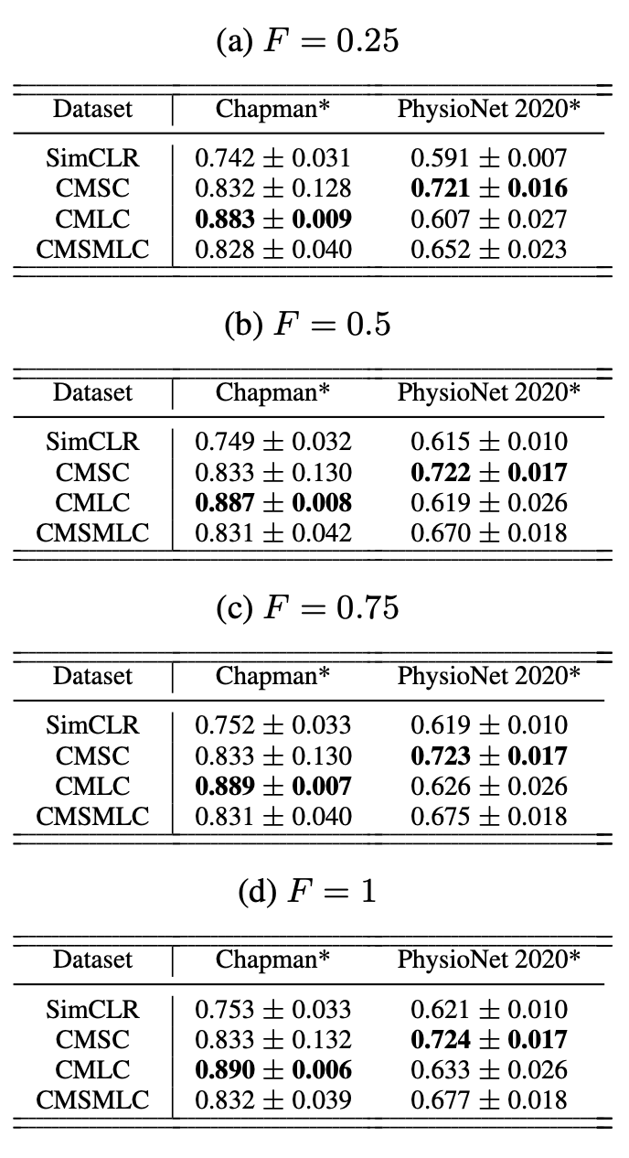
Evaluation- Linear Evaluation of Representations
E=32 64 128 256

Slide 10
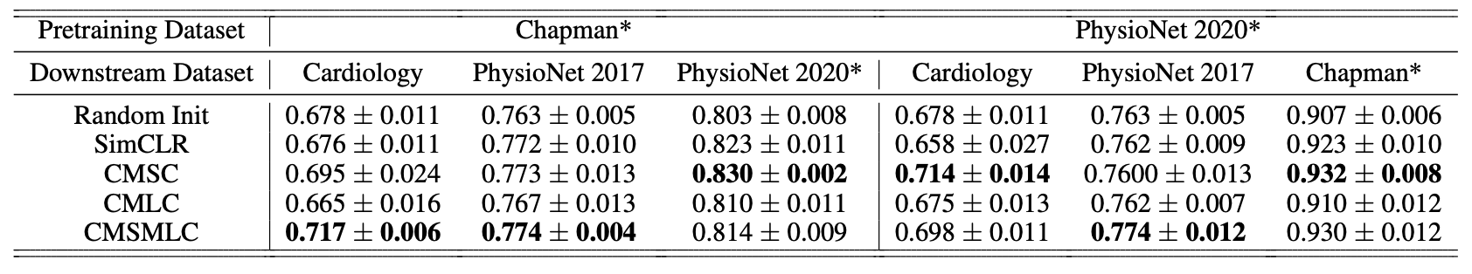
Evaluation- Transfer Capabilities of Representations
test AUC on downstream datasets at F = 0.5 for the various self-supervised methods with E = 128.

Slide 11
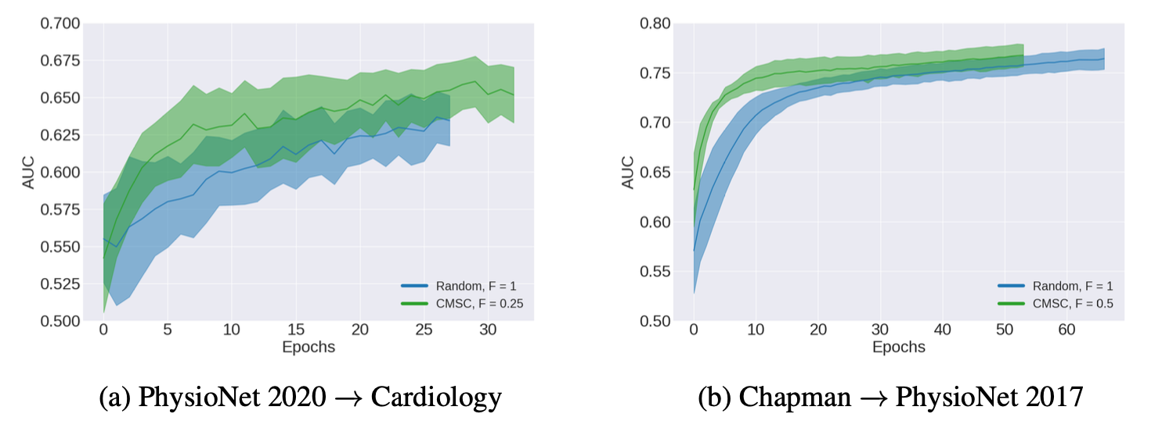
Doing More With Less Labelled Data
Validation AUC starting with a random and self-supervised initialization exposed to different amounts of labelled training data.

Slide 12
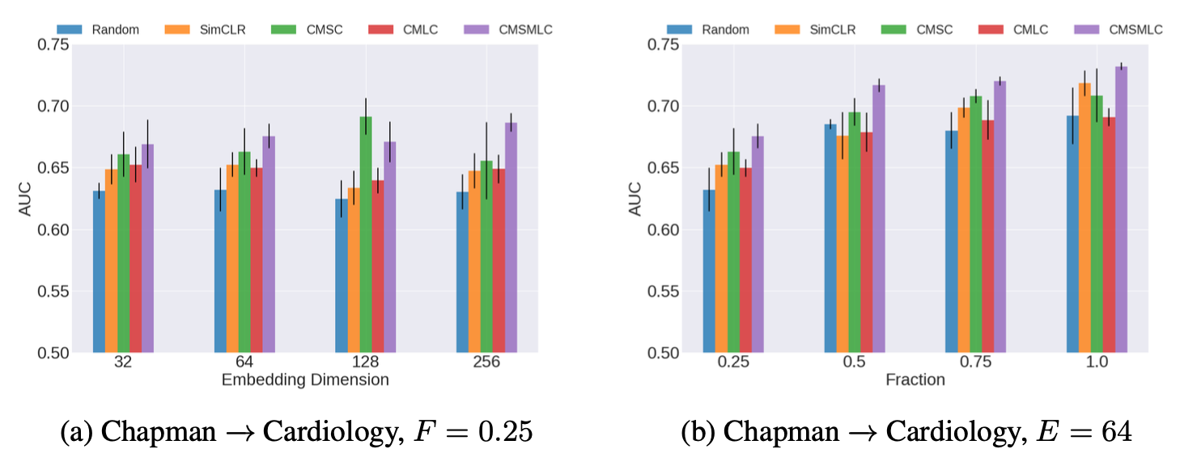
Effect of Embedding Dimension, E, and Availability of Labelled Data, F

Slide 13
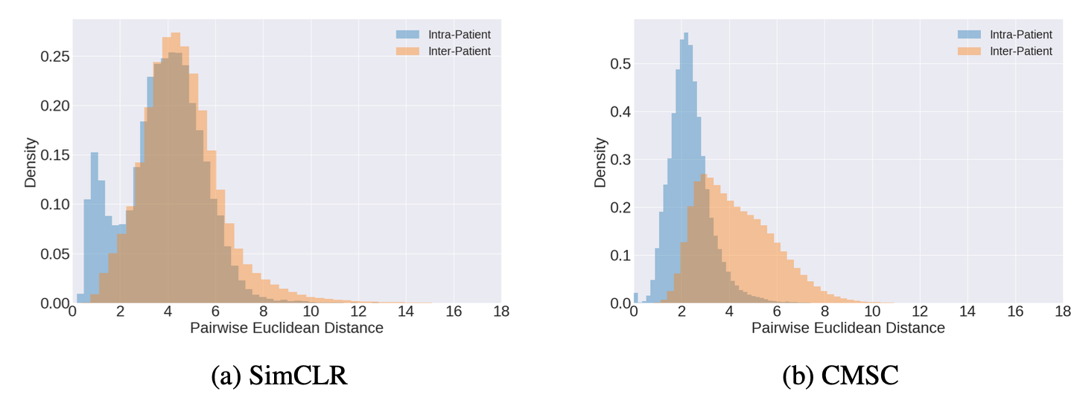
Patient-Specific Representations
Distribution of pairwise Euclidean distance between representations (E = 128) belonging to the same patient and those belonging to different patients. Self-supervision was performed on PhysioNet 2020. Notice the lower average intra-patient values and improved separability with CMSC.

Slide 14
Contrastive Learning
Xiaoyu Li
2020.5.22

Slide 15
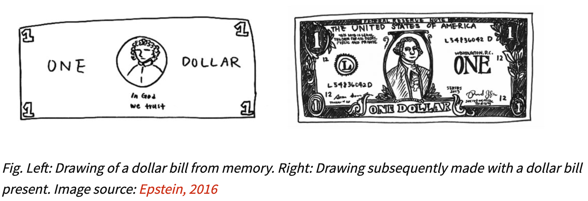
An illustrative example
Despite having seen a dollar bill countless number of times, we don’t retain a full representation of it. In fact, we really only retain enough features of the bill to distinguish it from other objects.

Slide 16
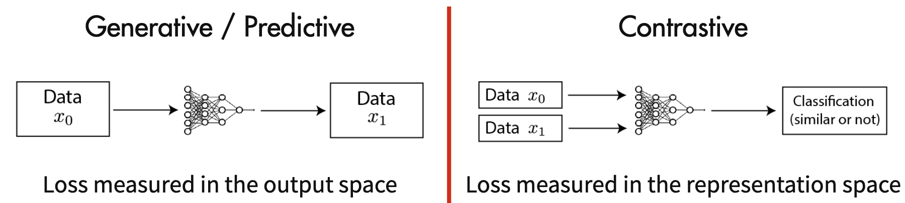
Generative vs Contrastive Methods
Contrastive methods aim to learn representations by enforcing similar elements to be equal and dissimilar elements to be different.

Slide 17
Generative vs Contrastive Methods
x1
X1’
Encoder
z1
Encoder
Same or not ?
Loss: Reconstruction Error
x1
Encoder
z1
Similar / Dissimilar?
x2
Encoder
z2

Slide 18
Generative vs Contrastive Methods
x1
Encoder
z1
Similar / Dissimilar?
x2
Encoder
z2
Two problems remain:
What is the loss?
How to get (x1, x2)?

Slide 19
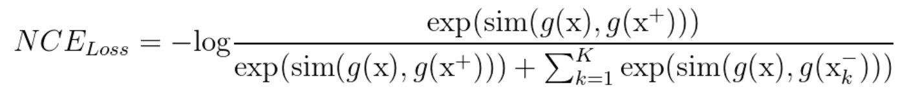
Noise Contrastive Estimator(NCE) Loss
sim(): function to measure similarity (Often, sim(.) is defined in terms of dot products or cosine similarities)
g(): encoder to map instance to its representation
x: commonly referred to as an anchor data point
x+: similar sample to x
x-: dissimilar sample to x
Then, key question is how to construct positive pair and negative pair.

Slide 20
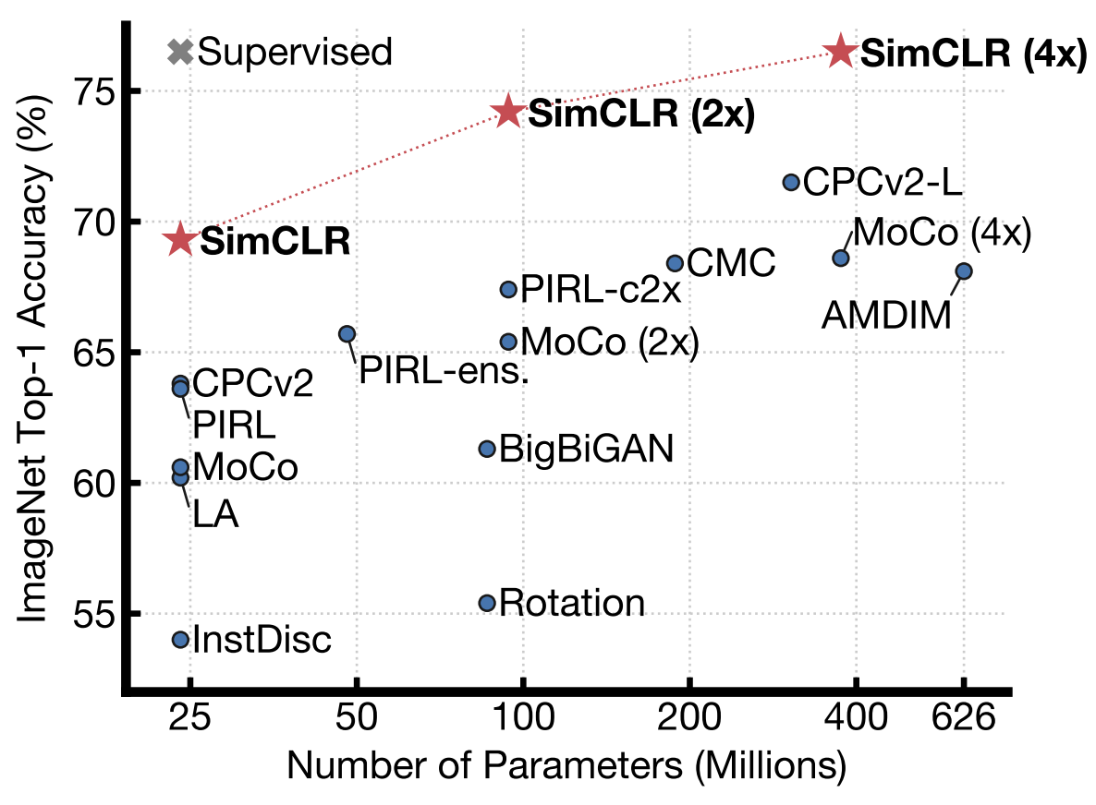
A Simple Framework for Contrastive Learning of Visual Representations(SimCLR)
ResNet50; Others: linear classification
Geoffrey Hinton
2020

Slide 21
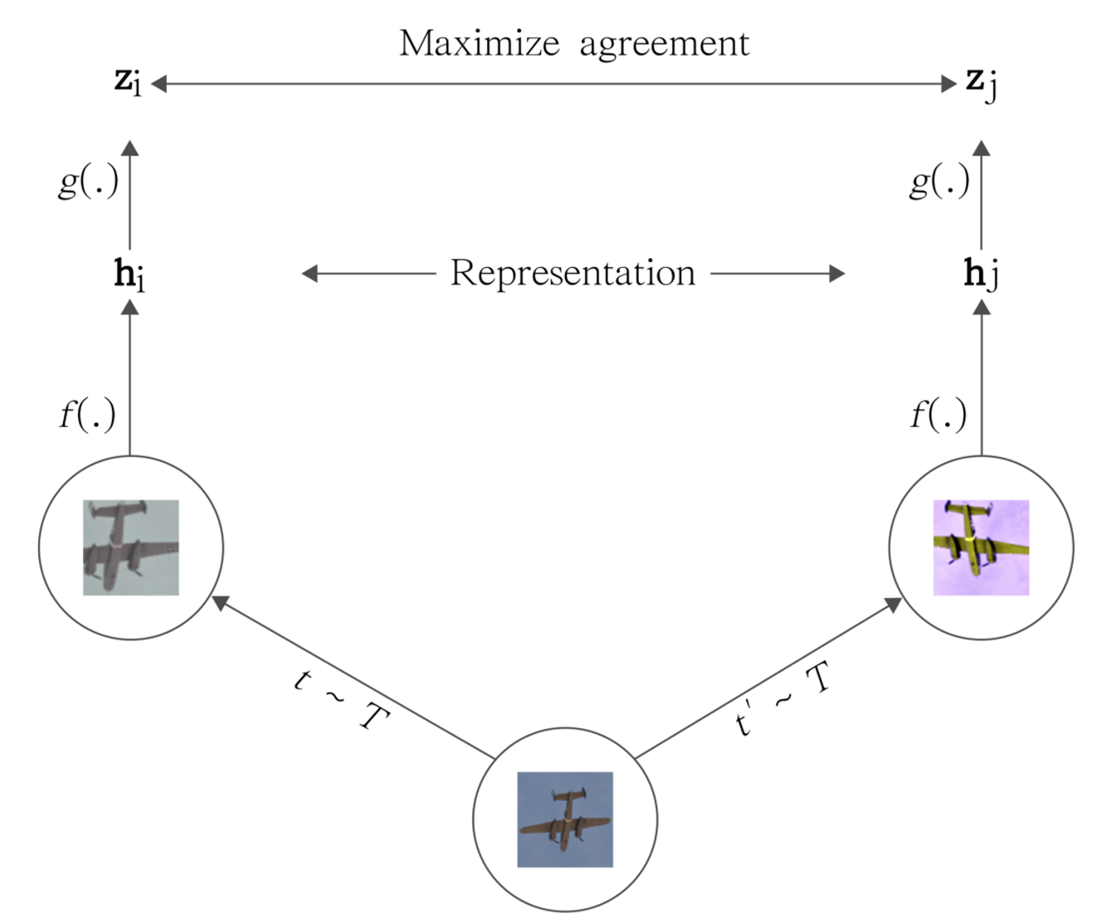
SimCLR
g(.): non-linear transformation
f(.): encoder
t~T: augmentation

Slide 22

SimCLR

Slide 23
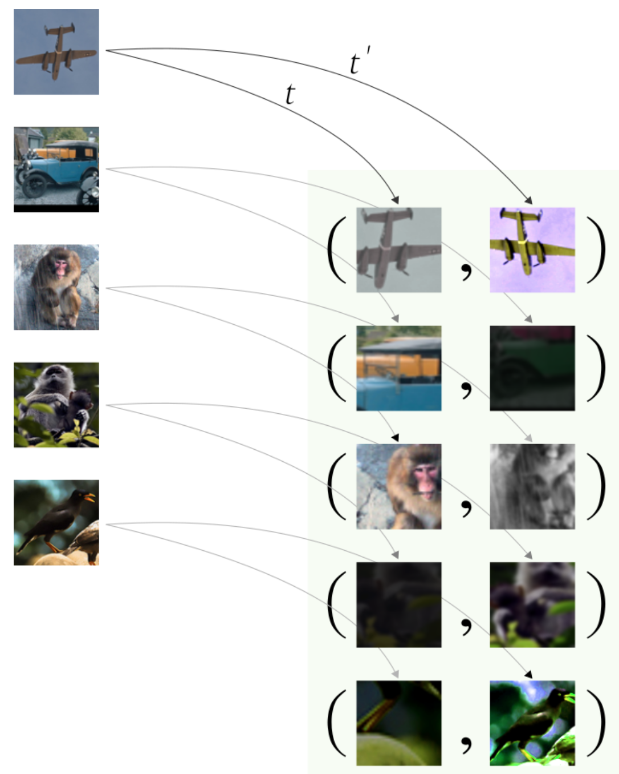
SimCLR Positive pairs
Augmentation

Slide 24
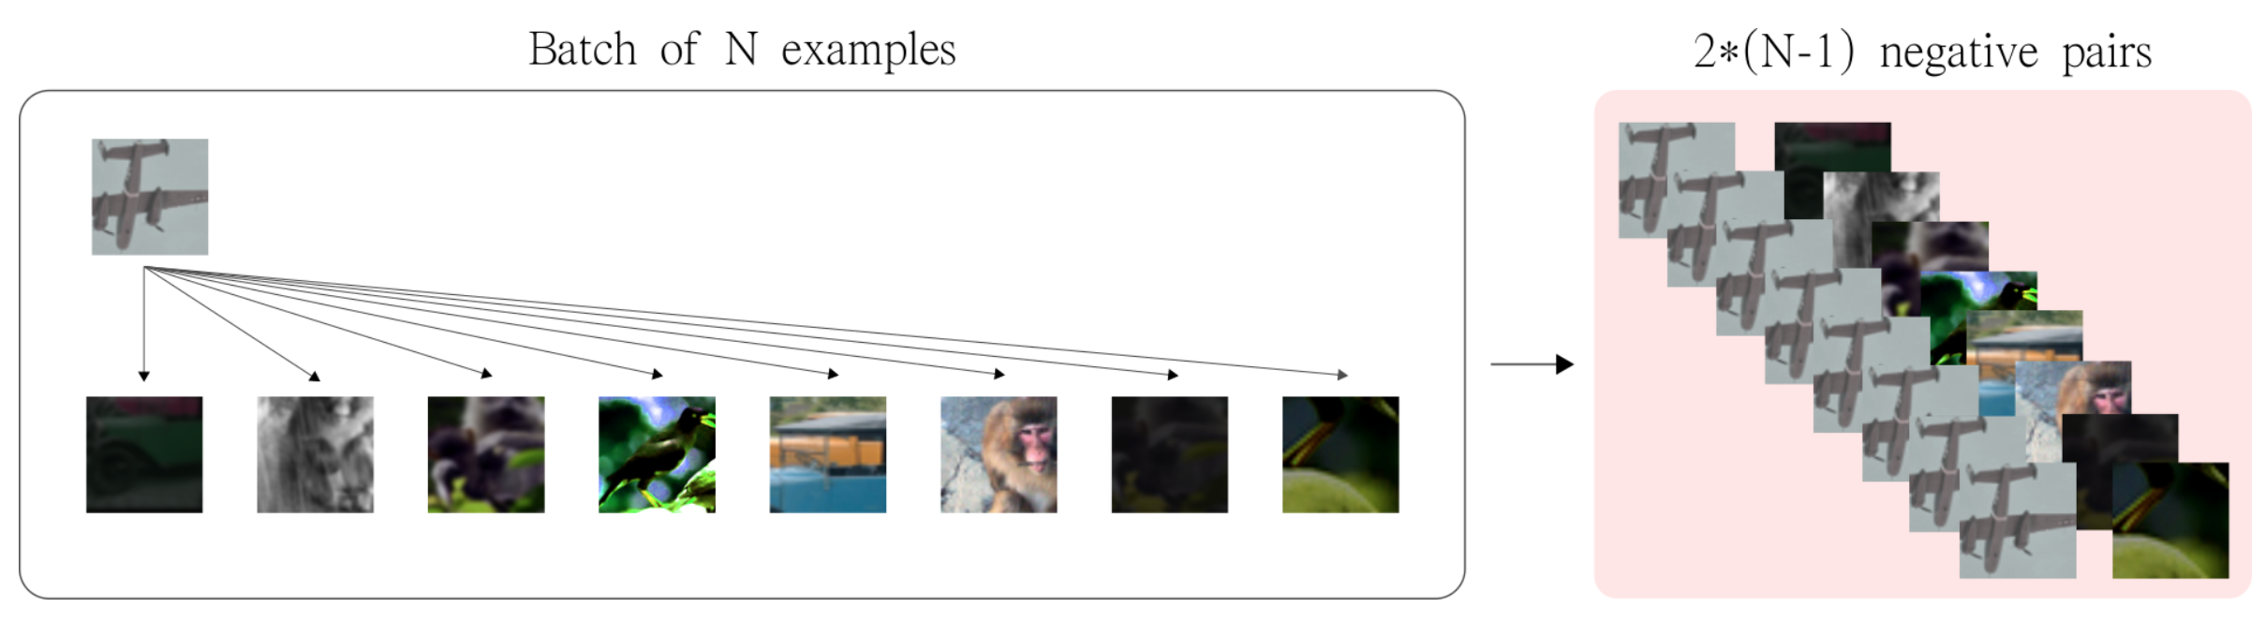
SimCLR Negative pairs

Slide 25
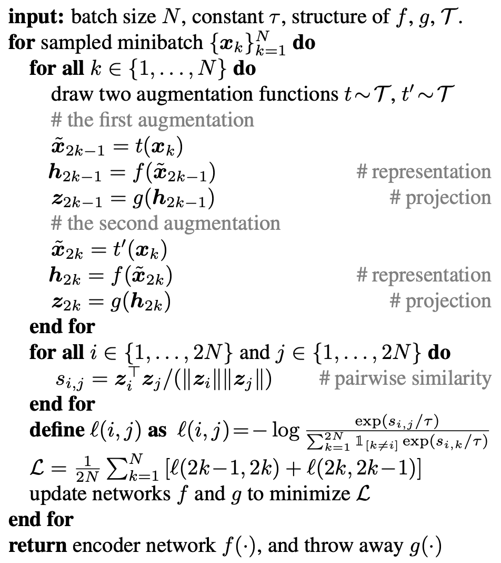
SimCLR
Algorithm
Cosine similarity
Loss

Slide 26
SimCLR
Composition of data augmentations plays a critical role in defining effective predictive tasks
Introducing a learnable nonlinear transformation between the representation and the contrastive loss substantially improves the quality of the learned representations
Contrastive learning benefits from larger batch sizes and more training steps compared to supervised learning

Slide 27
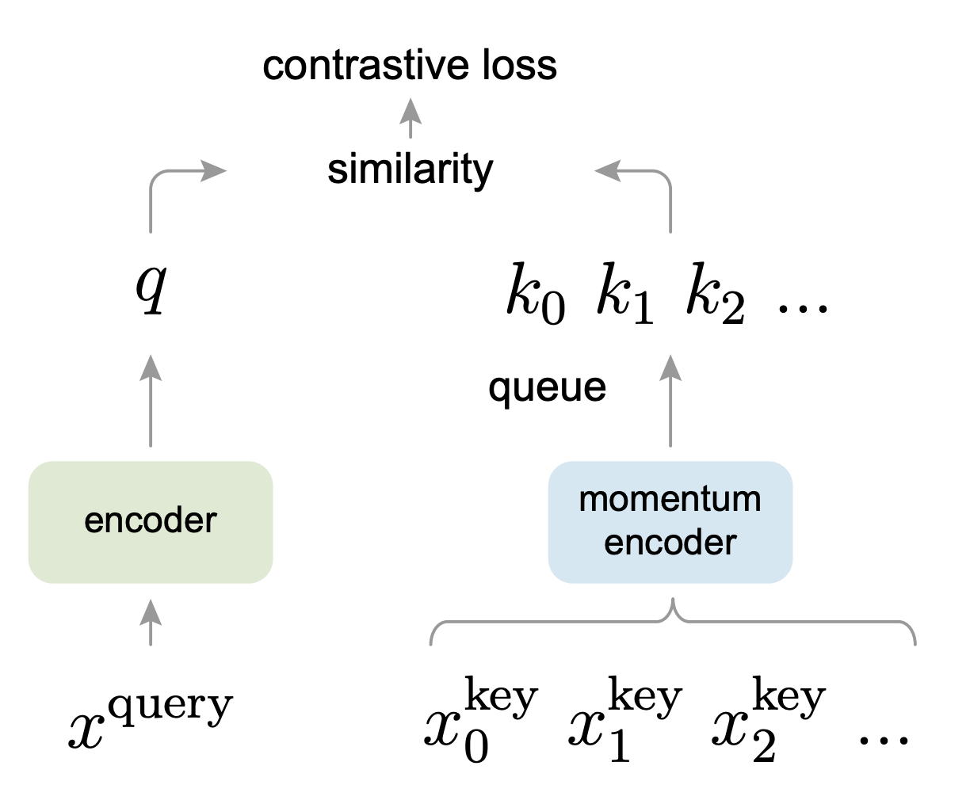
Momentum Contrast for Unsupervised Visual Representation Learning (MoCo)
Kaiming He
2020
MoCo can outperform its supervised pre-training counterpart in 7 detection/segmentation tasks on PASCAL VOC, COCO, and other datasets, sometimes surpassing it by large margins

Slide 28
MoCo
From the perspective of dictionary !
Why does BERT work?
Language tasks have discrete signal spaces (words, sub-word units, etc.) for building tokenized dictionaries, on which unsupervised learning can be based. Computer vision, in contrast, further concerns dictionary building [54, 9, 5], as the raw signal is in a continuous, high-dimensional space and is not structured for human communication (e.g., unlike words).
How the dictionary is supposed to be?
Large
Consistent as they evolve during training

Slide 29
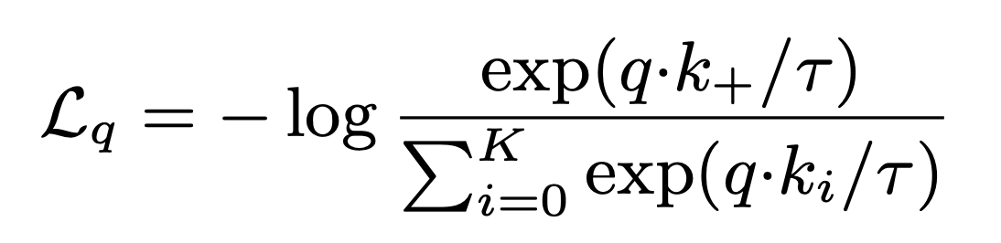
MoCo loss
Contrastive learning, and its recent developments, can be thought of as training an encoder for a dictionary look-up task.
Consider an encoded query q and a set of encoded samples {k0, k1, k2, ...} that are the keys of a dictionary.
τ is a temperature hyper-parameter

Slide 30
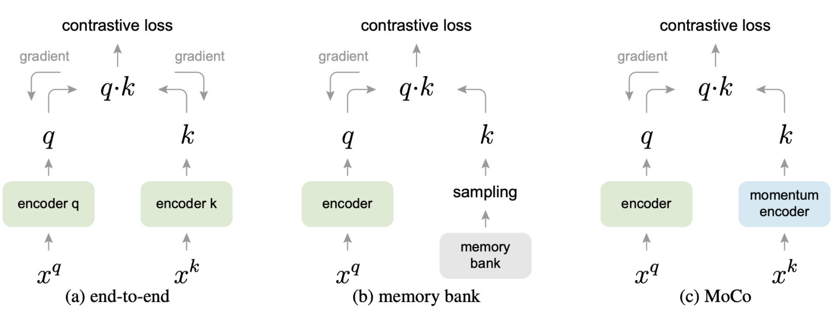
MoCo
k in a minibatch
k in training set
k in a queue

Slide 31
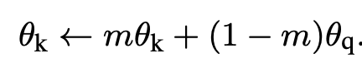
MoCo
k in a minibatch
k in training set
k in a queue
a relatively large momentum works better

Slide 32
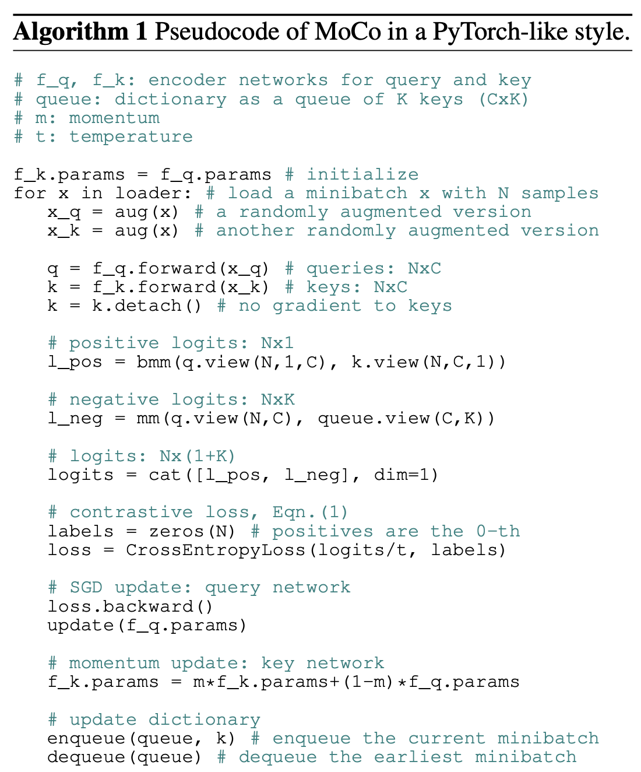
MoCo
Algorithm

Slide 33
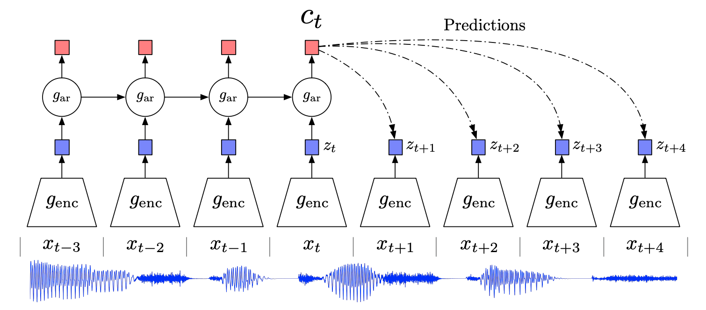
Representation Learning with Contrastive Predictive Coding (CPC)
DeepMind
2019
For any form
of data

Slide 34
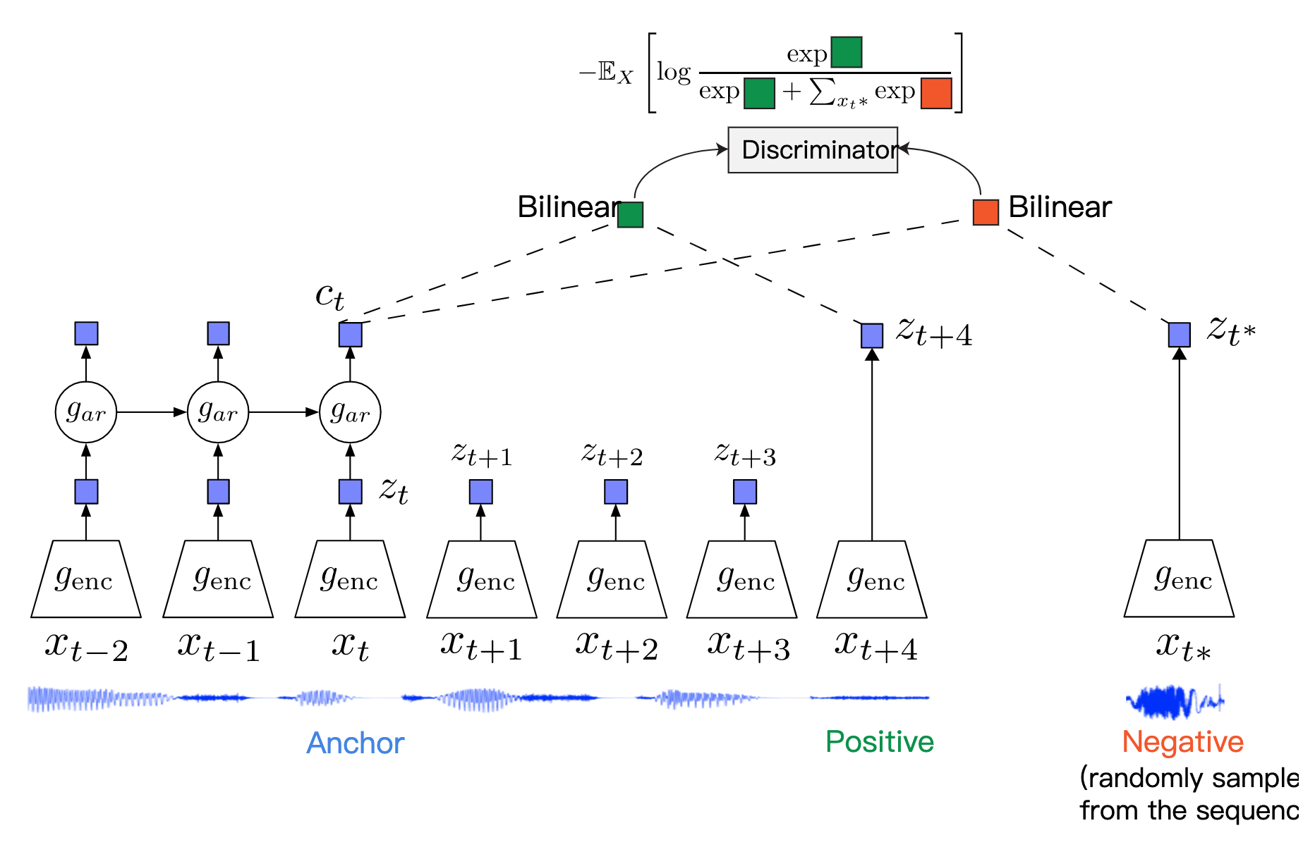
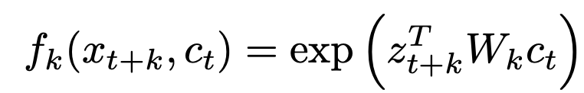
CPC
Let {x₁,x₂,…,x_{N}} be a sequence of data points, and x_{t} be an anchor data point. Then,
x_{t+k} will be a positive sample for this anchor.
A data point x_{t∗} randomly sampled from the sequence will be a negative sample.

Slide 35
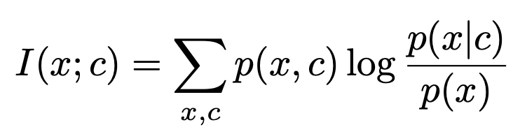
CPC
From the perspective of mutual information of x and context !
Main intuition: to learn the representations that encode the underlying shared information between different parts of the (high-dimensional) signal. When predicting further in the future, the amount of shared information becomes much lower, and the model needs to infer more global structure. These ‘slow features’ that span many time steps are often more interesting (e.g., phonemes and intonation in speech, objects in images, or the story line in books.).
Context c counts. Powerful conditional generative models are computationally intense, and waste capacity at modeling the complex relationships in the data x, often ignoring the context c.
Modeling p(x|c) directly may not be optimal for the purpose of extracting shared information between x and c. Images may contain thousands of bits of information while the high-level latent variables such as the class label contain much less information (10 bits for 1,024 categories).
Solution: to maximally preserve the mutual information of the original signals x and c:
= H(x) – H(x|c)

Slide 36
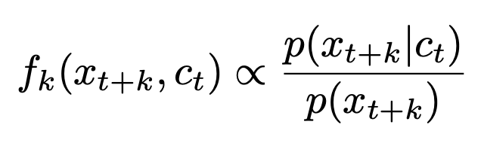
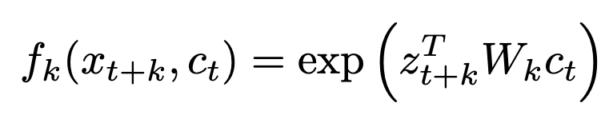
CPC
We do not predict future observations x_{t+k} directly with a generative model p_{k}(x_{t+k}|c_{t}). Instead we model a density ratio which preserves the mutual information between x_{t+k} and c_{t}
For simplicity

Slide 37
CPC
We do not predict future observations x_{t+k} directly with a generative model p_{k}(x_{t+k}|c_{t}). Instead we model a density ratio which preserves the mutual information between x_{t+k} and c_{t}
For simplicity
W_{k} c_{t} to predict z_{t+k}
Thus, this is just a dot product

Slide 38
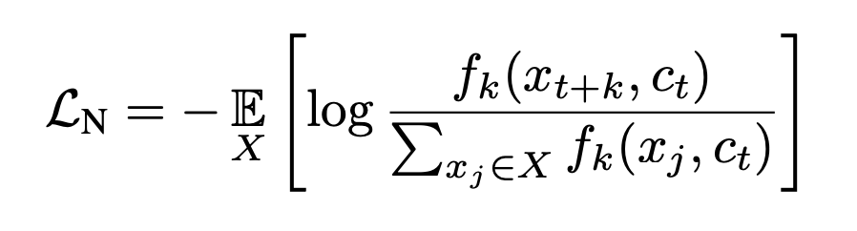
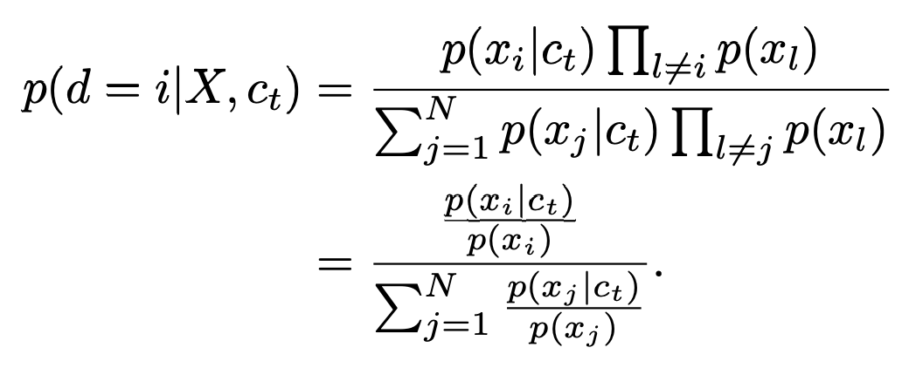
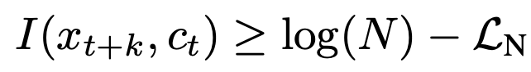
CPC loss
The categorical cross-entropy of classifying the positive sample correctly
The probability that sample x_{i} was drawn from the conditional distribution p(x_{t+k}|c_{t}) rather than the proposal distribution p(x_{t+k}) can be derived as follows
Proportional to mutual information
Additionally,

Slide 39
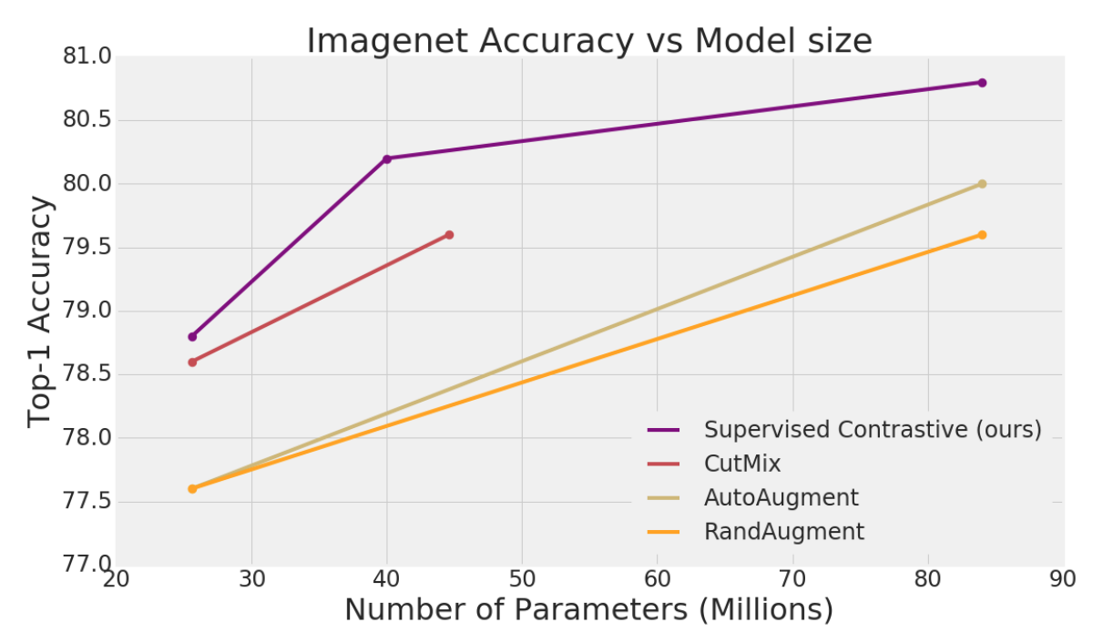
Supervised Contrastive Learning
MIT&Google
2020
modify the batch contrastive loss,
outperform cross entropy by over 1%

Slide 40
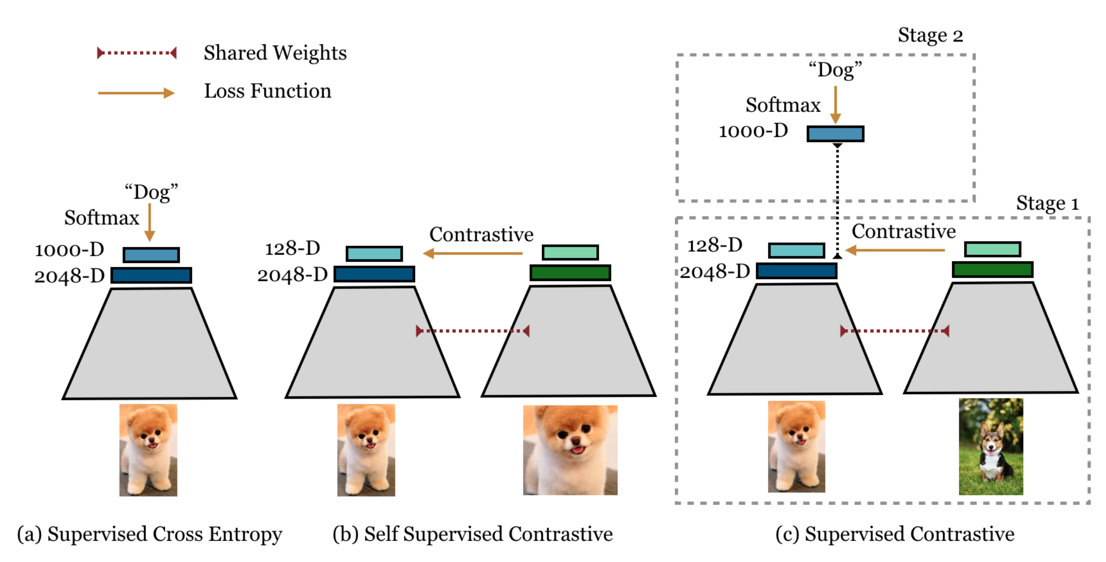

Slide 41
Thanks.
All of references please refer to https://shimo.im/docs/X6YHg9WpG3wjYXvH/ 「Contrastive Learning」

